Slide 1




Unleash the Power of Machine Learning: Predicting Bad Bunny's Billboard Dominance
POL688
04/24/24
Mario Morales

Slide 2
Unveiling the Secrets of Track Popularity
There are two main approaches to unraveling what makes a hit
Sociodemographics
Music Factors
Explore how people shape cultural trends
Uncover the key attributes that drive consumer choice

Slide 3





Spotify’s Sound Features
Sound Feature
Measurement
Definition
Peak
0 to 1
Track's peak position on the Billboard 'Hot 100'
Loudness
-60 to 1
Track's loudness in decibels
Valence
0 to 1
Track's musical positiveness
Energy
0 to 1
Track's perceived intensity and activity
Danceability
0 to 1
How suitable for dancing the track is?
Speechiness
0 to 1
Track's presence of spoken words
Liveness
0 to 1
Presence of an audience in the record
Key
0 to 11
Pitch Class notation
Mode/Melodic Scale
0 to 1
Scale from which track's melodic content is derived (minor vs. major)
Year
2017 to 2023
Track's year of release

Slide 4
Collecting Data
Where and How?
Spotify API
Billboard Chart
AllMusic
spotify
BeautifulSoup

Slide 5
Behind the Scenes: Building the Ultimate Bad Bunny Dataset
Cleaning
1
I removed duplicates, complete cases, and homogenized variable names.
2
Pre-processing
This included double-checking years and ensuring we had the closest matches for each song.
Subsetting
3
I split our dataset into three subsets: full, training, and testing.
4
Merging
I merged Spotify and Billboard data to get a complete picture of Bad Bunny's success.

Slide 6
Breaking Down the Science of Predictive Modeling
Explore the Key Steps to Building a Predictive Regression Model for New Data
1
Tools
2
Metric
I used supervised predictive models to build a regression model, which allowed we to make accurate predictions based on previous data.
I focused on minimizing the average out-of-sample Root Mean Square Error for the regression models to avoid overfitting, ensuring that our predictions were as accurate as possible.
3
Aim
4
Final Model
I compared cross-validation linear models and Random Forest models, using the TuneLength function to try three different values for each tuning parameter in the model and selecting hyperparameters based on out-of-sample error.
I selected the final model based on the smallest value of RMSE, ensuring that our predictions were as accurate as possible and giving me the best possible insights into Bad Bunny's success on the Billboard charts.

Slide 7
Descriptive Statistics
Variables
Overall
Variables
Overall
(N=93)
(N=93)
Peak (1-100)
Speechiness (0 to 1)
Mean (SD)
49.8 (27.9)
Mean (SD)
0.136 (0.110)
Median [Min, Max]
53.0 [1.00, 98.0]
Median [Min, Max]
0.0800 [0.0300, 0.490]
Loudness (-60 to 0)
Liveness (0 to 1)
Mean (SD)
-5.43 (1.66)
Mean (SD)
0.173 (0.132)
Median [Min, Max]
-5.16 [-10.6, -2.25]
Median [Min, Max]
0.120 [0.0600, 0.670]
Valence (0 to 1)
Pitch (0 to 11)
Mean (SD)
0.481 (0.214)
Mean (SD)
5.62 (3.35)
Median [Min, Max]
0.470 [0.100, 0.940]
Median [Min, Max]
6.00 [0, 11.0]
Energy (0 to 1)
Modality (0=minor to 1=major)
Mean (SD)
0.685 (0.114)
Mean (SD)
0.495 (0.503)
Median [Min, Max]
0.690 [0.410, 0.900]
Median [Min, Max]
0 [0, 1.00]
Danceability (0 to 1)
Year (2017-2023)
Mean (SD)
0.752 (0.103)
Mean (SD)
2020 (1.58)
Median [Min, Max]
0.780 [0.500, 0.910]
Median [Min, Max]
2020 [2017, 2023]
"Loudness" sets the stage with a mean of -5.43 and a median of -5.16, unleashing a wave of powerful sounds. The tracks come alive with "Energy," boasting a mean of 0.685 and infusing them with an irresistible vigor. "Modality" takes listeners on a melodic journey, effortlessly transitioning between minor and major keys. And with a mean of 0.752, "Danceability" invites everyone to unleash their inner dancer. The "Year" variable spans from 2017 to 2023, with a mean of 2020, capturing a dynamic and ever-evolving timeframe for the data collection.

Slide 8
OLS Model
Term
Estimate
Std.error
Statistic
p.value
(Intercept)
-145.689
45.939
-3.171
0.002
Loudness
0.066
0.027
2.43
0.018
Valence
-0.16
0.165
-0.966
0.338
Energy
-0.801
0.396
-2.024
0.047
Danceability
0.604
0.33
1.829
0.072
Speechiness
0.276
0.321
0.86
0.393
Liveness
0.206
0.243
0.851
0.398
Key
-0.019
0.009
-1.973
0.053
Mode
-0.198
0.067
-2.973
0.004
Year
0.073
0.023
3.197
0.002
For every one-unit increase in the track's loudness in decibels, the peak position on the Billboard 'Hot 100' increases by approximately 0.066 units.
For every one-unit increase in the track's perceived intensity and activity, the peak position on the Billboard 'Hot 100' decreases by approximately 0.801 units.
Tracks derived from a minor scale tend to have a lower peak position on the Billboard 'Hot 100' compared to tracks derived from a major scale.
For every one-year increase in the track's year of release, the peak position on the Billboard 'Hot 100' increases by approximately 0.073 units.

Slide 9
Comparison of the Models
Model
RMSE
Rsquared
MAE
Linear Regression
0.279
0.306
0.221
Random Forest (Untuned)
0.257
0.304
0.211
Random Forest (Tuned)
0.271
0.282
0.223
The linear regression model has a moderate performance in predicting the outcome variable. It has a relatively higher RMSE compared to the other models, indicating larger prediction errors.
Among the three models, the untuned random forest model performs the best overall, with the lowest RMSE and MAE values.
Model
RMSE
MAE
Linear Regression
0.238
0.185
Ranger (Untuned)
0.129
0.101
Ranger (Tuned)
0.127
0.101
Both the untuned and tuned ranger models outperform the linear regression model in terms of prediction accuracy, as indicated by their lower RMSE and MAE values. The similarity in RMSE and MAE between the untuned and tuned ranger models suggests that tuning hyperparameters did not significantly improve prediction accuracy in this case.

Slide 10
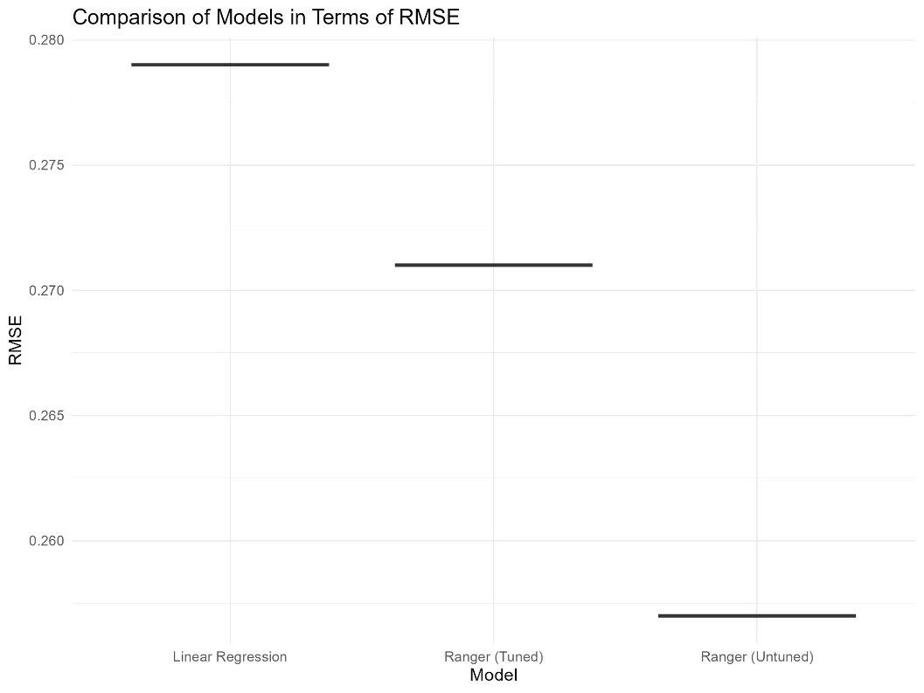
Comparison of Models in Terms of RMSE

Slide 11
Prediction of the tracks’ peak position on the Billboard 'Hot 100'
Number
Peak
Name
2
0.79
Monaco
14
0.77
Vuelve Candy b
9
0.74
Gracias Por Nada
4
0.73
Hibiki
11
0.72
Baby Nueva
5
0.7
Mr. October
18
0.68
Thunder y Lightning
8
0.67
Seda
1
0.66
Nadie Sabe
7
0.65
Vou 787
15
0.65
Baticano
6
0.63
Cybertruck
17
0.63
where She Goes
19
0.59
Perro Negro
16
0.57
No Me Quiero Casar
3
0.56
Fina
12
0.56
Mercedes Carota
20
0.55
Acho Pr
21
0.55
Un Preview
10
0.47
Telefono Nuevo
13
0.46
Los Pits

Slide 12

MONACO

Slide 13
Challenges
How to run Machine Learning Models?
DataCamp and Workshop.
How to get all Bad Bunny’s tracks?
Request by artist and track after comparing Spotify, Billboard and AllMusic datasets.
How to scrap Billboard data?
BeautifulSoup tutorials.

Slide 14
Tools
Software & Packages
Python
Pandas - Several tasks
Spotipy - Request of information
BeautifulSoup - Web scraping
RStudio
dplyr – Several tasks
stringi – Remove accents
stringdist – Find closest match
caret – Machine learning models
tibble, boot & broom- Tables

Slide 15

Next Steps
Dependent variable
Observations
Models
Billboard peak vs. Spotify popularity.
Bad Bunny vs. Latin Grammy nominees.
Test more Machine Learning models.

